Slide 1


Development of Defense Game based on UNITY
UNITY
DEFENSE GAME
공개SW프로젝트 8조 김래향, 김민선

Slide 2
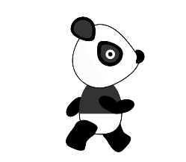
목차
Development of Defense Game based on UNITY
Panda Sprite
Animation 생성
Animation 조건 수정
구현
USING OPEN SOURCE

Slide 3


PANDA SPRITE
Development of Defense Game based on UNITY
Enemy 역할의 Panda Sprite
Walk : Path 따라 이동
Die : 컵케이크 타워의 발사체가 판다를 쓰러뜨림
Hit : 컵케이크 타워의 발사체가 판다를 맞춤
Eat : 판다가 컵케이크를 먹음

Slide 4
PANDA SPRITE
Development of Defense Game based on UNITY
animation_panda_walk 0 ~ 10
Walk : Path 따라 이동

Slide 5

PANDA SPRITE
Development of Defense Game based on UNITY
animation_panda_die 0 ~ 9
Die : 컵케이크 타워의 발사체가 판다를 쓰러뜨림

Slide 6
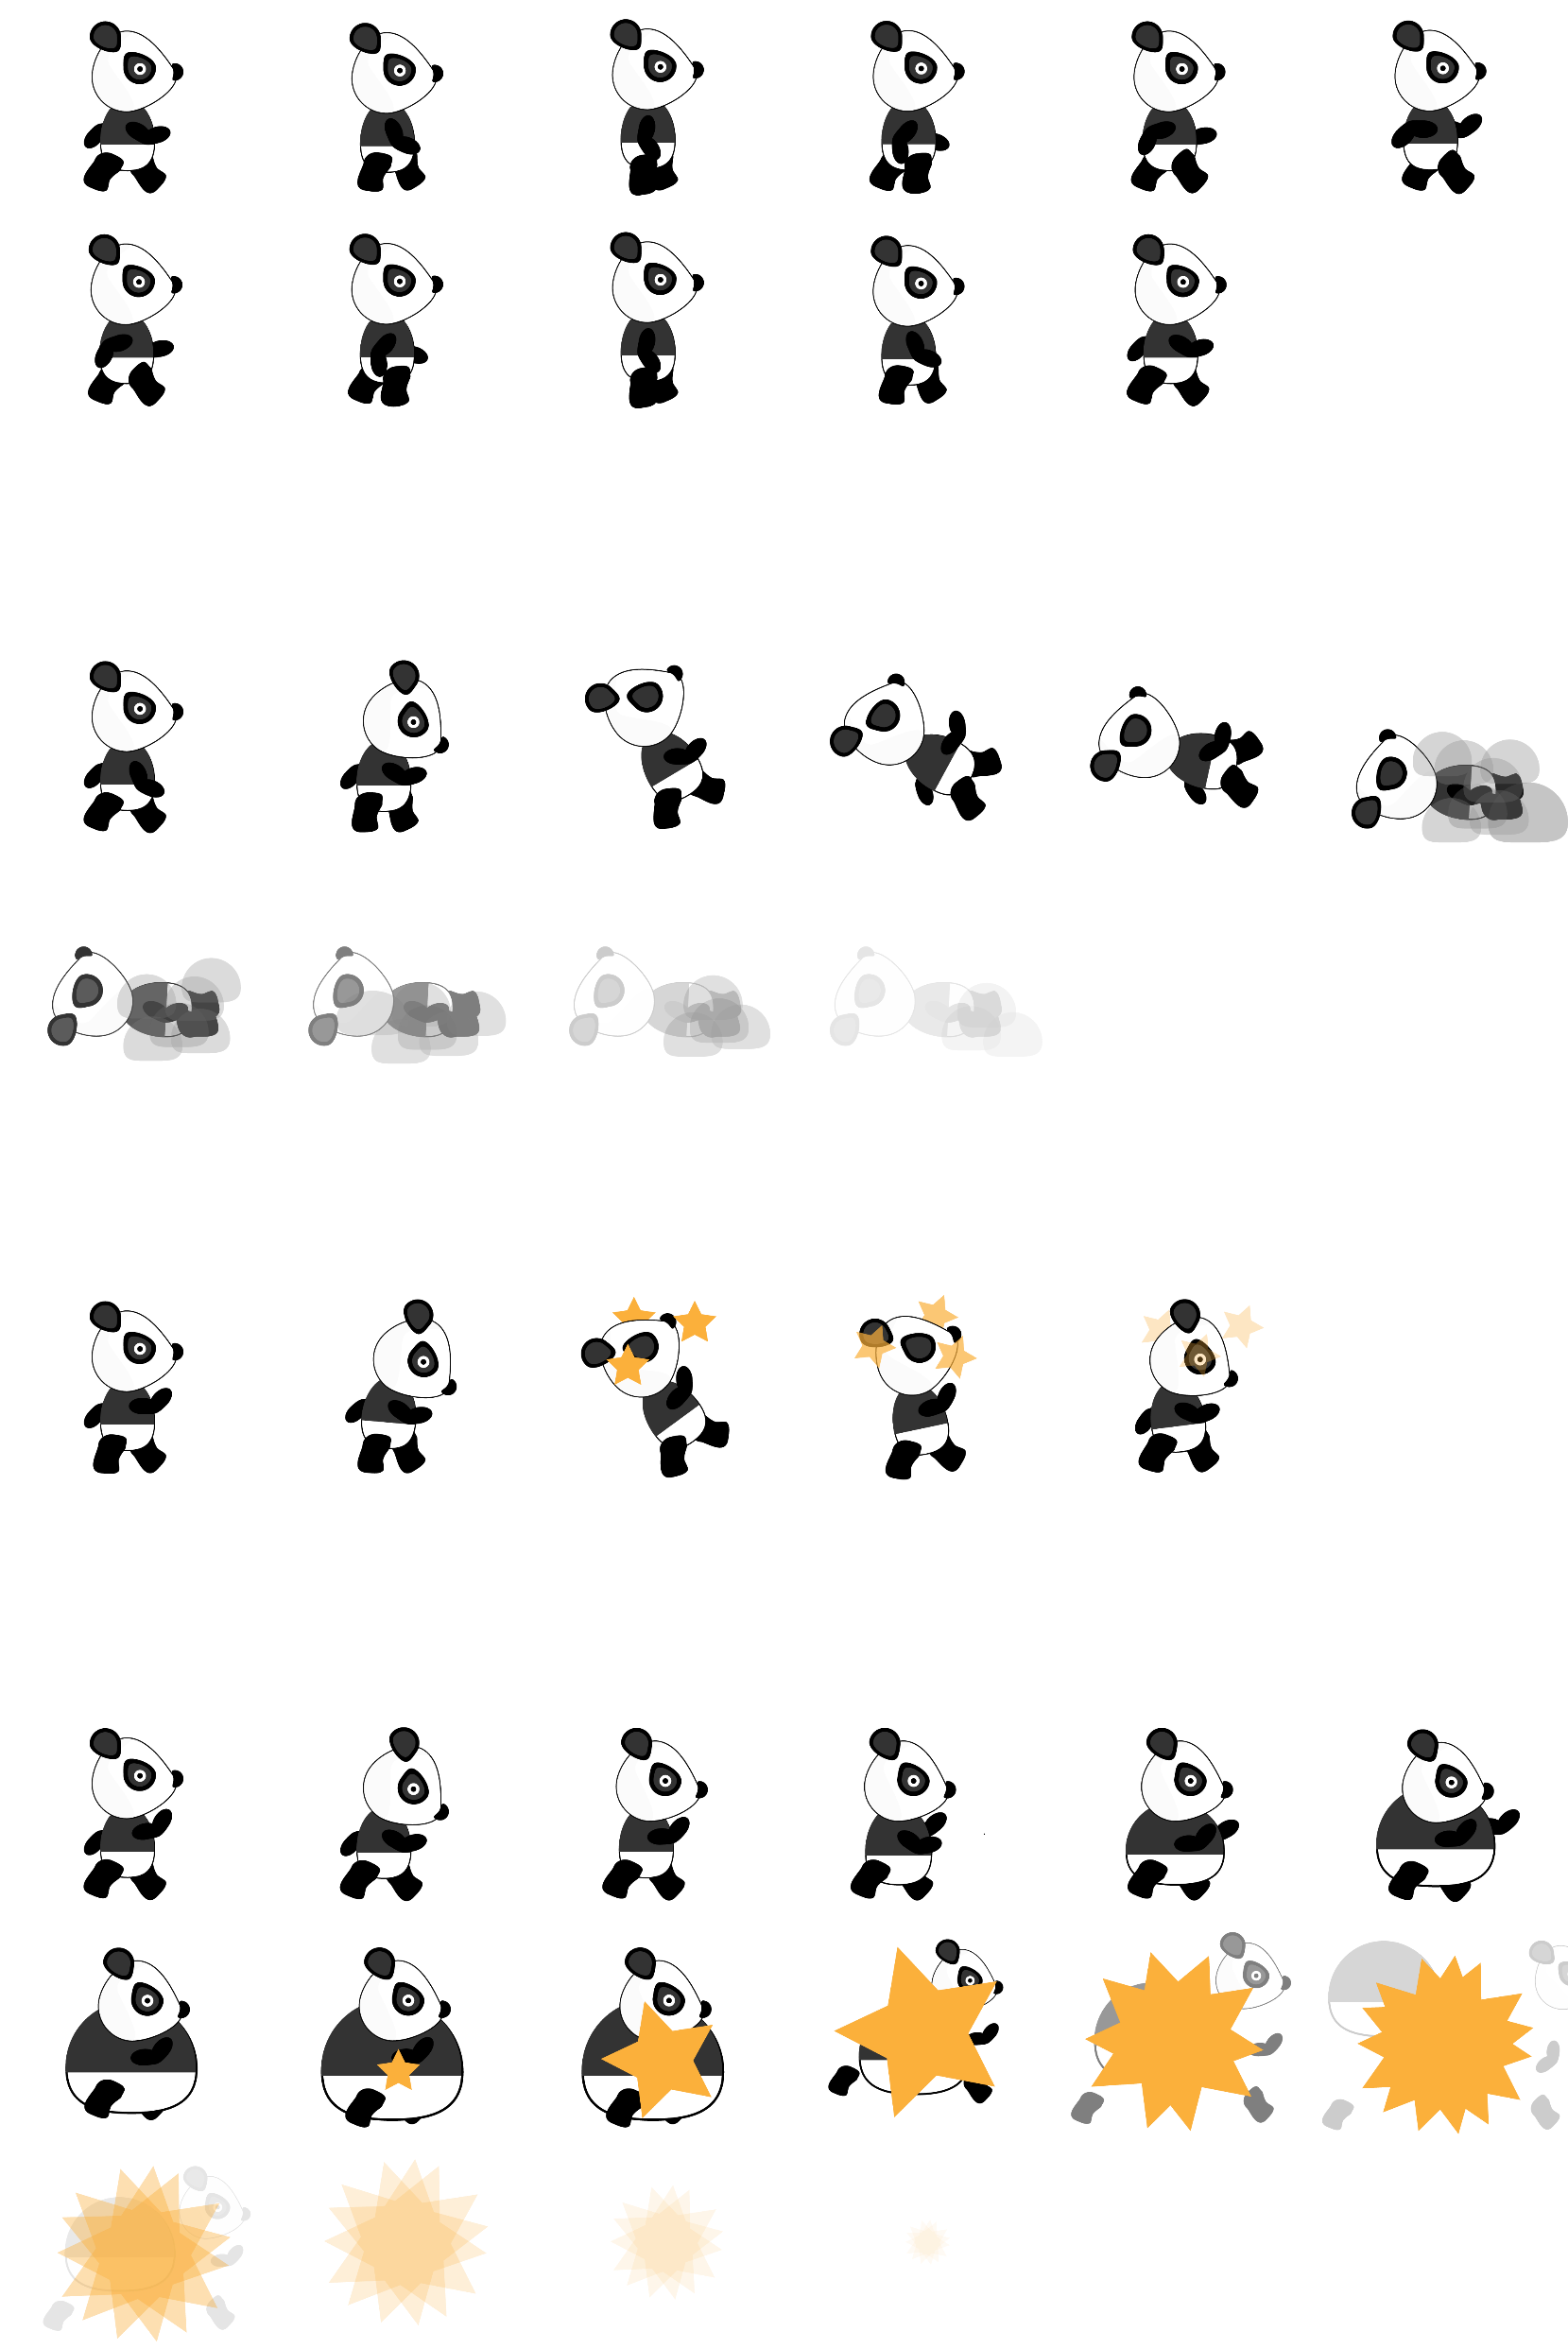
PANDA SPRITE
Development of Defense Game based on UNITY
animation_panda_hit 0 ~ 4
Hit : 컵케이크 타워의 발사체가 판다를 맞춤

Slide 7
PANDA SPRITE
Development of Defense Game based on UNITY
animation_panda_eat 0 ~ 15
Eat : 판다가 컵케이크를 먹음

Slide 8
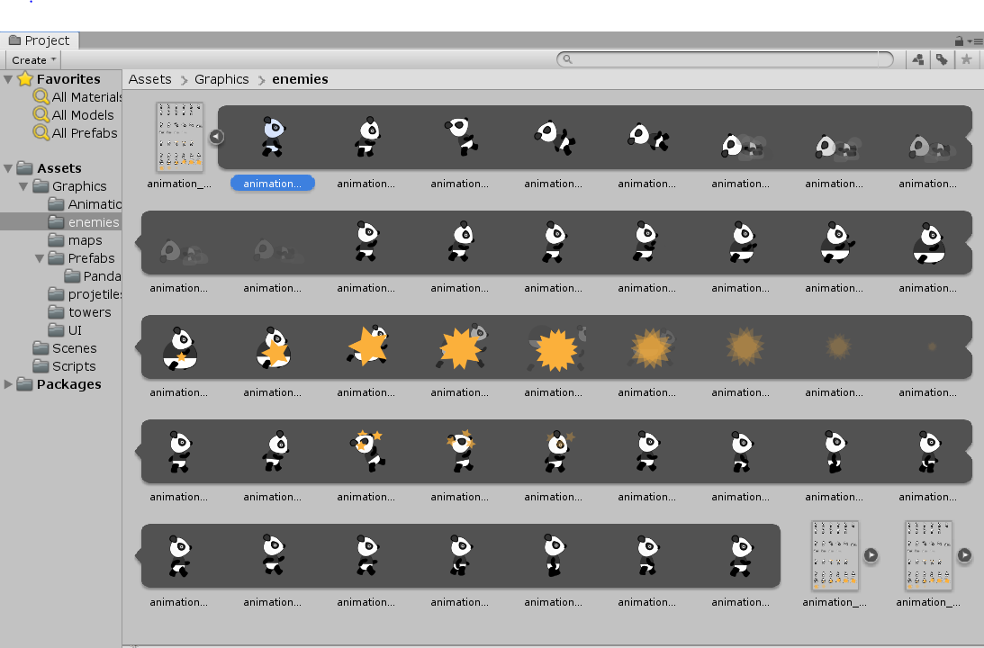
PANDA SPRITE
Development of Defense Game based on UNITY

Slide 9
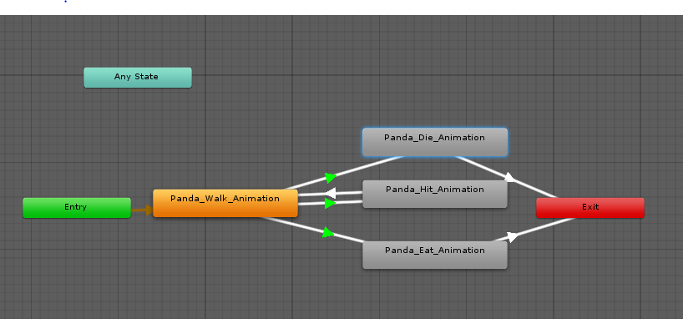
Animation 생성
Development of Defense Game based on UNITY
Animation 생성
Panda_Walk_Animation
Panda_Die_Animation
Panda_Hit_Animation
Panda_Eat_Animation
각 Animation들이 어떻게 유기적으로 연결되어 동작하는가?

Slide 10
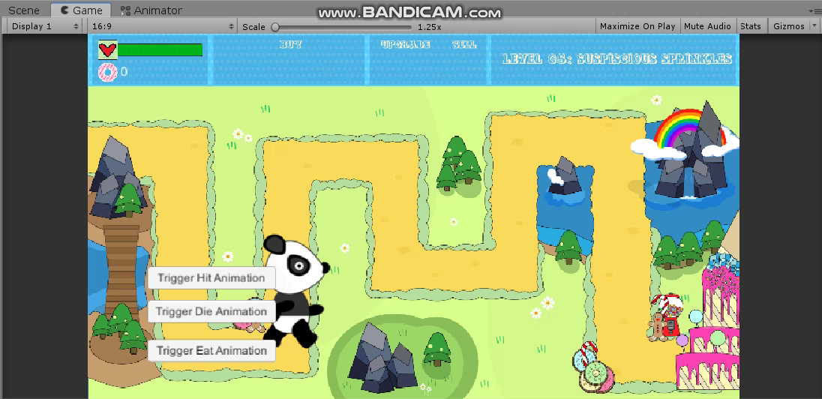
Animation 생성
Development of Defense Game based on UNITY
DEFAULT : Panda_Walk_Animation - LOOP

Slide 11
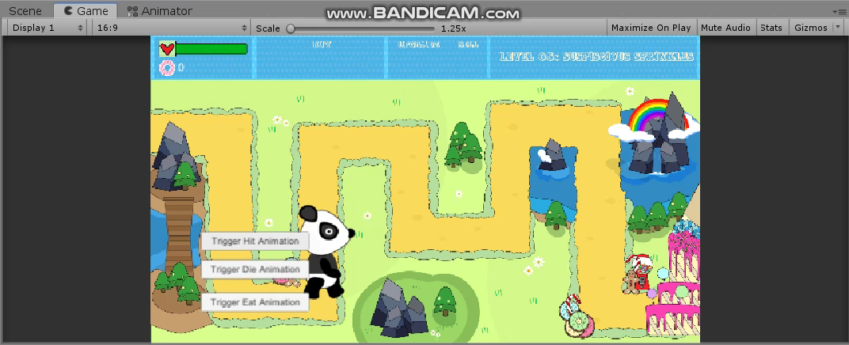
Animation 생성
Development of Defense Game based on UNITY
Panda_Die_Animation

Slide 12
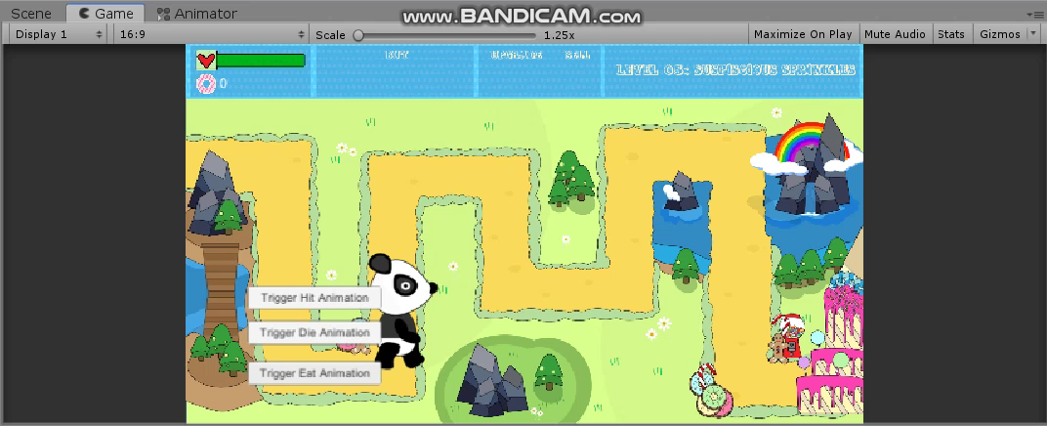
Animation 생성
Development of Defense Game based on UNITY
Panda_Hit_Animation

Slide 13
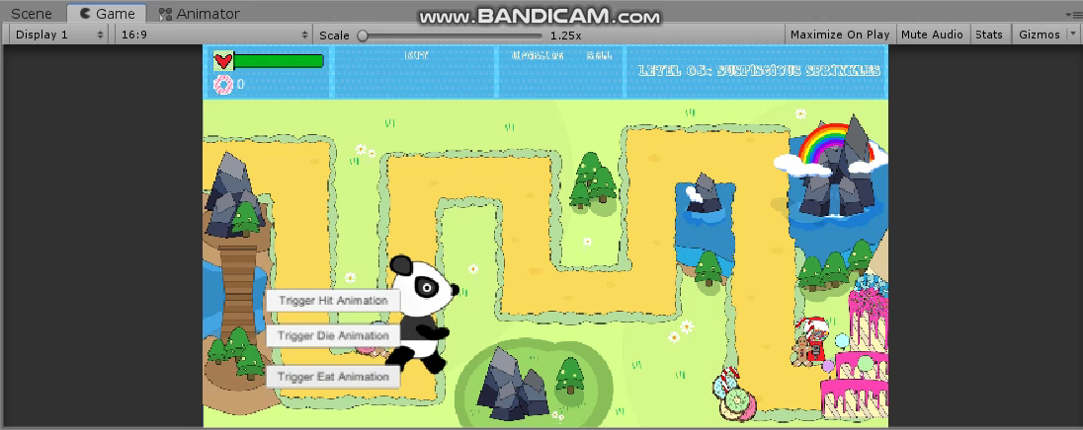
Animation 생성
Development of Defense Game based on UNITY
Panda_Eat_Animation

Slide 14
Animation 생성
Development of Defense Game based on UNITY
Default로 Panda_Walk_Animation이 LOOP로 돌아가므로,
아래 Animation이 실행되더라도 다시 Panda_Walk_Animation으로 진행되는 오류 해결 필요
Panda_Die_Animation
Panda_Eat_Animation
실행 후 판다 Destroy 만족하게 변경

Slide 15
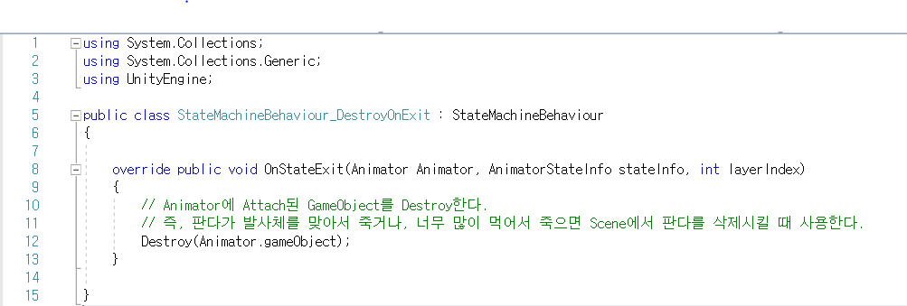
Animation 생성
Development of Defense Game based on UNITY

Slide 16

Animation 생성
Development of Defense Game based on UNITY
Panda_Die_Animation

Slide 17

Animation 생성
Development of Defense Game based on UNITY
Panda_Eat_Animation

Slide 18
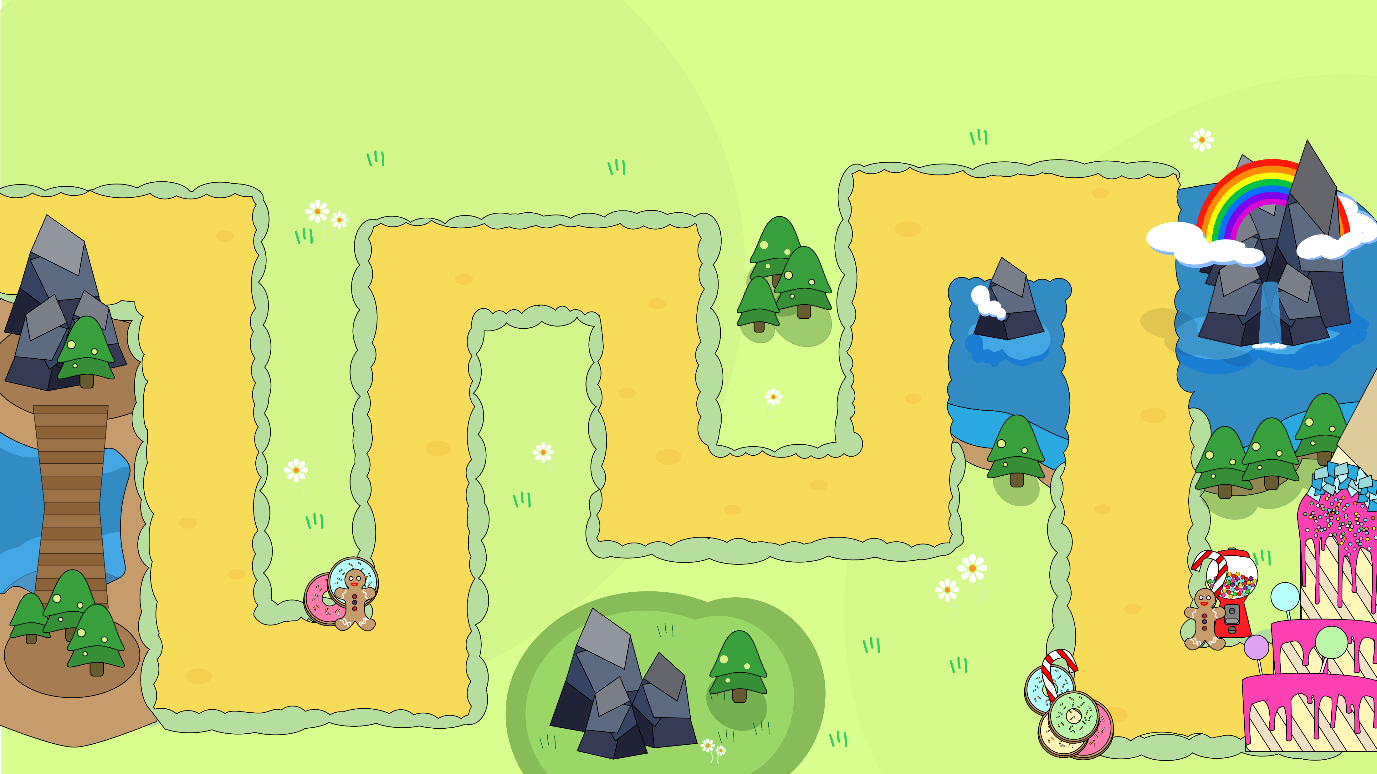
NEXT GOAL
Development of Defense Game based on UNITY
판다가 실제로 목표 지점을 향해 가야함
Animation들을 어떤 상황에서 변경하여 실행하여야 할지 할당해주어야 할 것

Slide 19
THANK YOU!
Development of Defense Game based on UNITY
공개SW프로젝트 8조 김래향, 김민선

